Slide 1
RECAP ON PYTHON (version used 2.7)
Syntax, data structures, control flow, sockets, Threads

Slide 2
introduction
Distributed Real-Time Cyber Physical System of Systems - Puccetti Tommaso e Secci Francesco
Python is an interpreted and interactive language.
Python features a dynamic type system and automatic memory management.
Python supports multiple programming paradigms, including object-oriented, imperative, functional and procedural, and has a large and comprehensive standard library.

Slide 3
Properties
Distributed Real-Time Cyber Physical System of Systems - Puccetti Tommaso e Secci Francesco
Strongly typed → you can’t concatenate a string and an integer for example;
Dinamically, implicitly typed → you don’t have to explicitly declare variable data types. Data types are enforced at runtime;
Case sensitive → for example, pippo and PIPPO are not the same variables;
Object-oriented → everything is an object.

Slide 4
Indentation
Distributed Real-Time Cyber Physical System of Systems - Puccetti Tommaso e Secci Francesco
Python programs get structured through indentation, i.e. code blocks are defined by their indentation.
In the case of Python it's a language requirement not a matter of style.
This principle makes it easier to read and understand other people's Python code.
All statements with the same distance to the right belong to the same block of code.

Slide 5
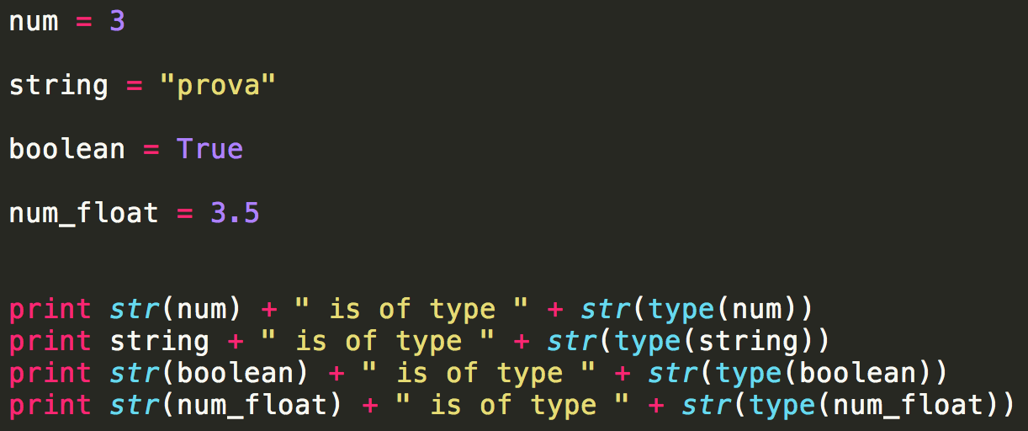
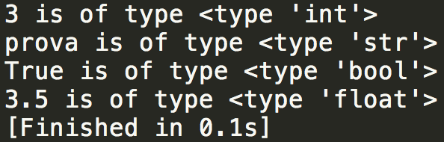
Variables declaration
Distributed Real-Time Cyber Physical System of Systems - Puccetti Tommaso e Secci Francesco

Slide 6
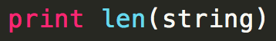
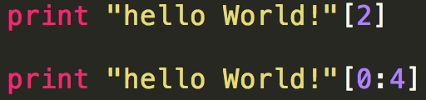
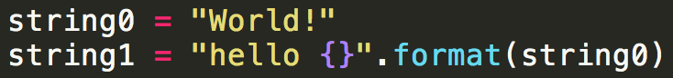
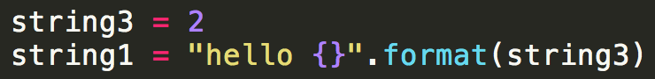
Manipulating strings
Distributed Real-Time Cyber Physical System of Systems - Puccetti Tommaso e Secci Francesco
Given a string, the function return the length of it. In this case is 12.
Using this notation you can access a set of, or single character(s).
With this syntax you can format values into string…
…also an integer.

Slide 7
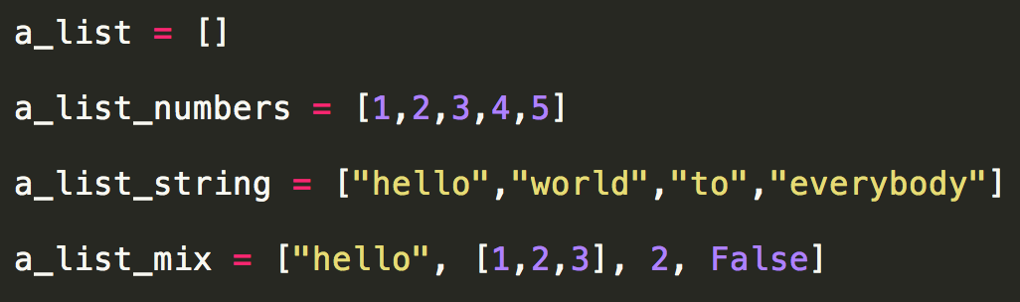
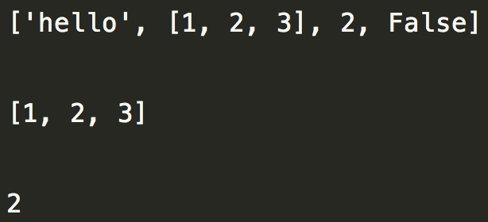
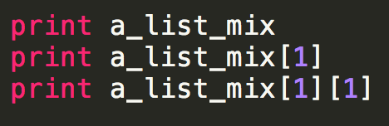
Manipulating lists
Distributed Real-Time Cyber Physical System of Systems - Puccetti Tommaso e Secci Francesco
Python lists may contain any data types and you can also create mixed list.
If you use negative values, you can access the list from the bottom.

Slide 8
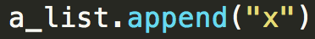
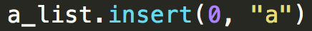
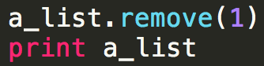
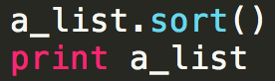
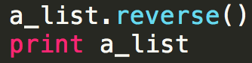
Manipulating lists (continue)
Distributed Real-Time Cyber Physical System of Systems - Puccetti Tommaso e Secci Francesco
Add an item to the end of the list.
Extend the list by appending all the items in the given list.
Insert an item at a given position.
Return the number of times "a" appears in the list.
Remove the first item from the list whose value is 1 (error if it is not present).
Sort the items of the list in place.
Reverse the elements of the list, in place.

Slide 9
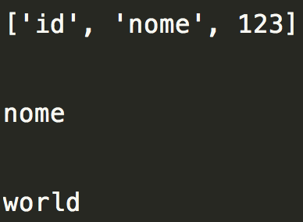
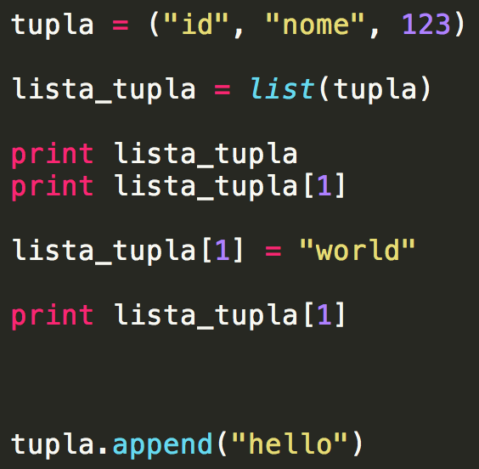
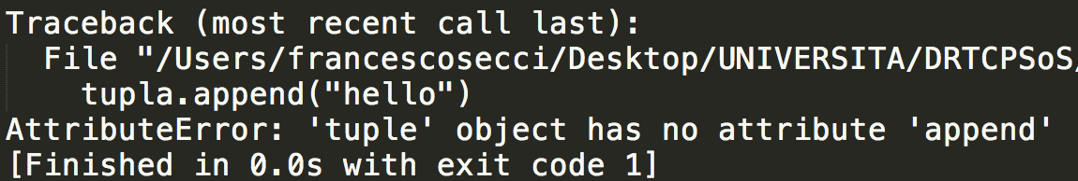
tuples
Distributed Real-Time Cyber Physical System of Systems - Puccetti Tommaso e Secci Francesco
Tuples are similar to lists, but they are immutable, which means they cannot be changed after creation. As we see in the example above, the tuple was converted to a list before being manipulated.

Slide 10
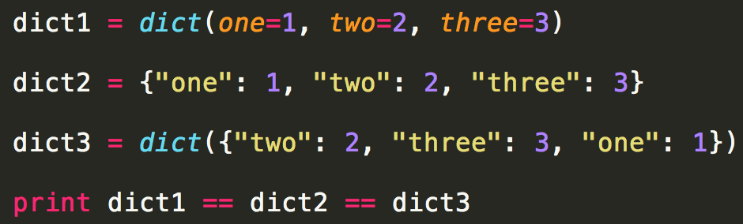
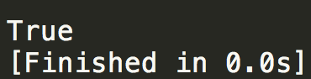
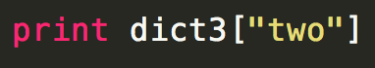
dictionaries
Distributed Real-Time Cyber Physical System of Systems - Puccetti Tommaso e Secci Francesco
Dictionaries are a type of associative array implemented using hash tabels containing key/value pairs. They are unordered.
The first object of each item becomes a key in the new dictionary, the second object corrisponding value.
output
The result is 2 for each dictionary created.

Slide 11
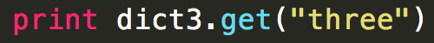
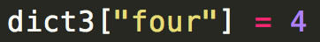
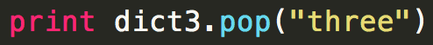
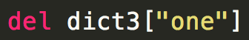
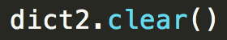
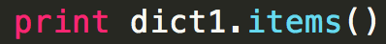
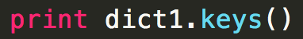
Dictionaries (continue)
Distributed Real-Time Cyber Physical System of Systems - Puccetti Tommaso e Secci Francesco
Use .get() to access the value of the key three.
This notation is used for add an item to the dictionary.
This method removes the item with the provided key.
.popitem() can be used to remove and return an arbitrary item (key, value) from the dictionary (removes the first of a list).
del is used to delete a particular item in the dictionary.
.clear() removes all items.
Return a new view of the dictionary’s items (key, value).
Return a new view of the dictionary’s keys.

Slide 12
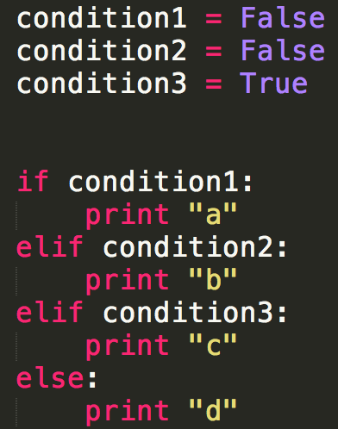
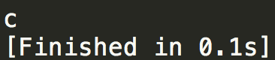
Control flow – if
Distributed Real-Time Cyber Physical System of Systems - Puccetti Tommaso e Secci Francesco
There can be zero or more elif parts, and the else part is optional. The keyword elif is short for «else if», and it is usefull to avoid excessive indentation. An if…elif…elif… sequence is a substitute for the switch or case statement found in other languages.
In this case the result is:

Slide 13
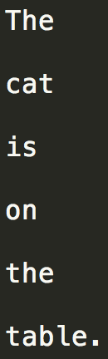
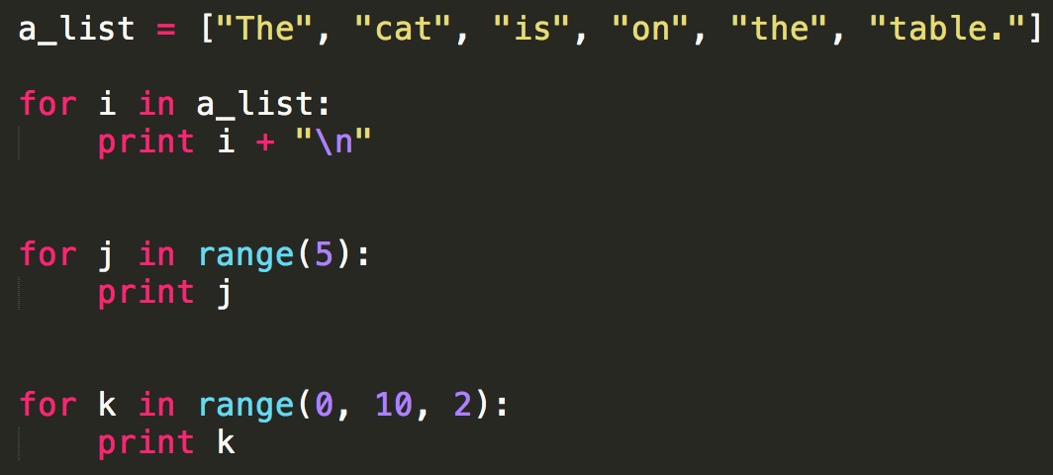

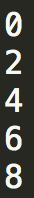
Control flow – for
Distributed Real-Time Cyber Physical System of Systems - Puccetti Tommaso e Secci Francesco

Slide 14
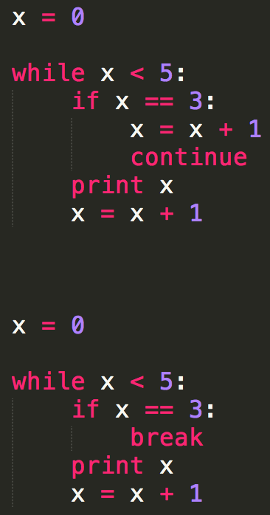


Control flow – while (break and continue)
Distributed Real-Time Cyber Physical System of Systems - Puccetti Tommaso e Secci Francesco
The continue statement in Python returns the control to the beginning of the while loop. The continue statement rejects all the remaining statements in the current iteration of the loop and moves the control back to the top of the loop.
The break statement in Python terminates the current loop and resumes execution at the next statement.

Slide 15
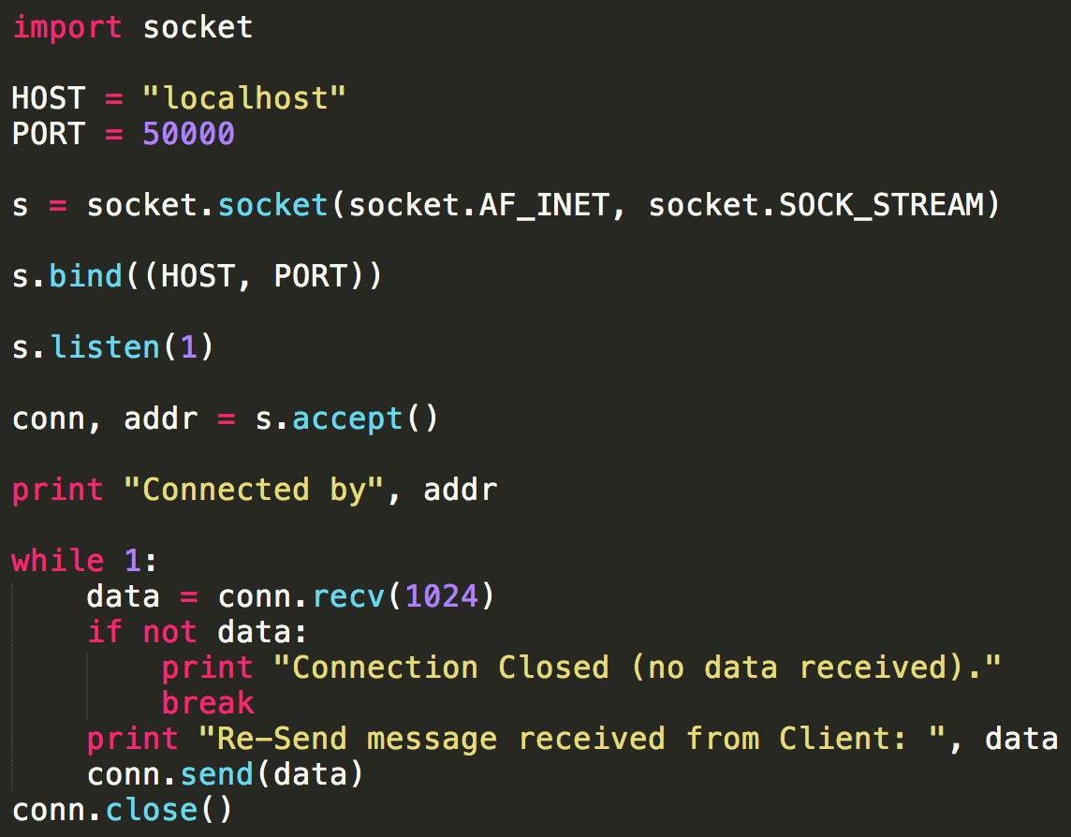
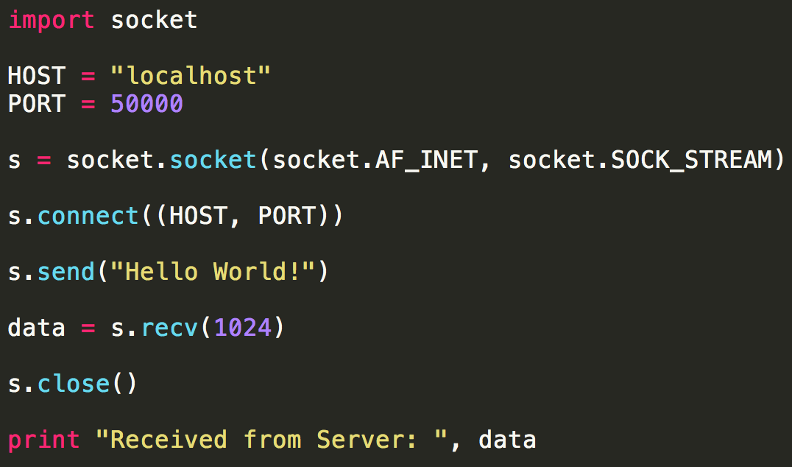
SOCKETs – echo server (1 interaction and close)
Distributed Real-Time Cyber Physical System of Systems - Puccetti Tommaso e Secci Francesco
Server
Client

Slide 16
SOCKETs - Question
Distributed Real-Time Cyber Physical System of Systems - Puccetti Tommaso e Secci Francesco
If I want to manage more than one client?

Slide 17
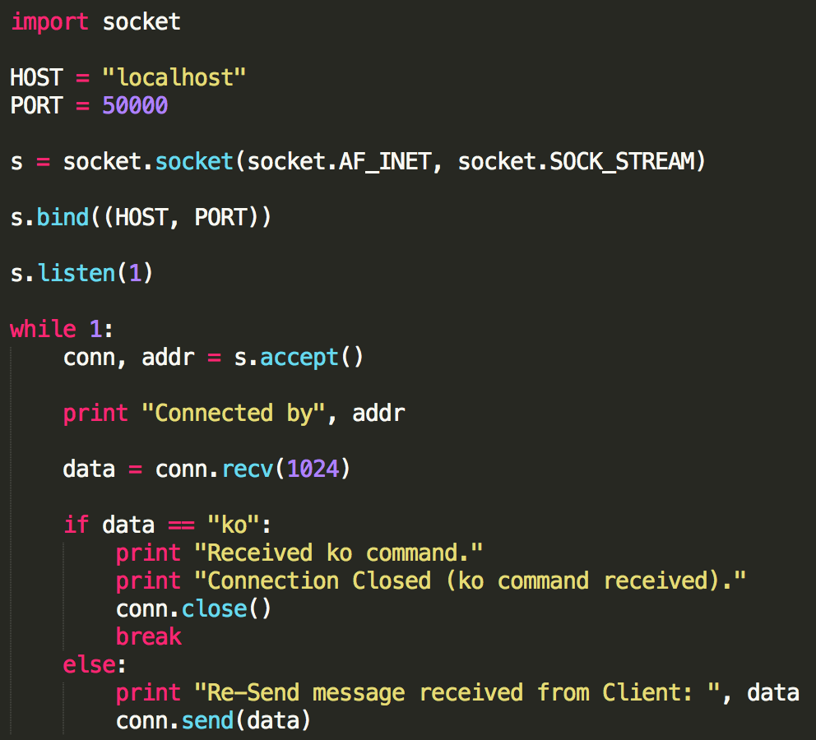
SOCKETs – echo server (more than one client)
Distributed Real-Time Cyber Physical System of Systems - Puccetti Tommaso e Secci Francesco
Modified Server

Slide 18
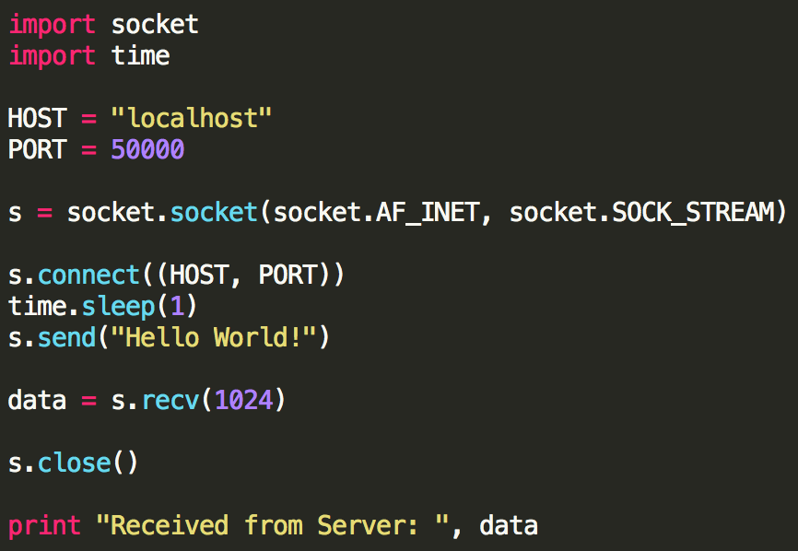
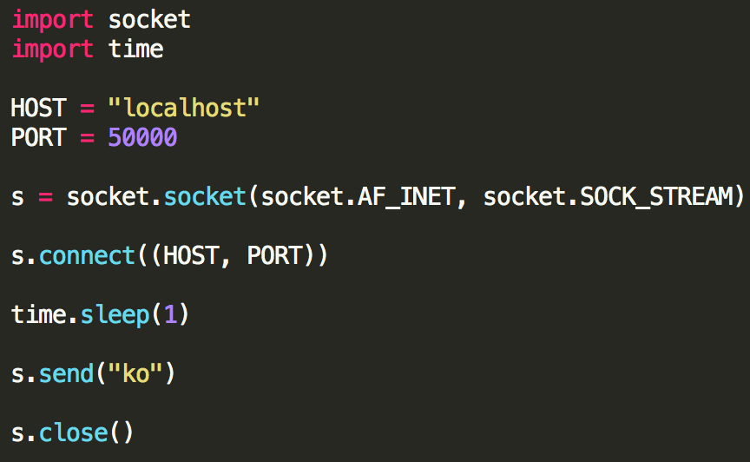
SOCKETs – echo server (more than one client)
Distributed Real-Time Cyber Physical System of Systems - Puccetti Tommaso e Secci Francesco
Modified Client1
Modified Client2

Slide 19
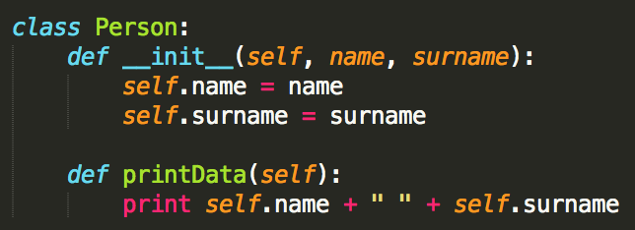
Class declarations
Distributed Real-Time Cyber Physical System of Systems - Puccetti Tommaso e Secci Francesco
__init__() method is the constructor of the class.
self is a keyword similar the this in Java. It is used to refer to an instance of the declared class (variables and method).

Slide 20
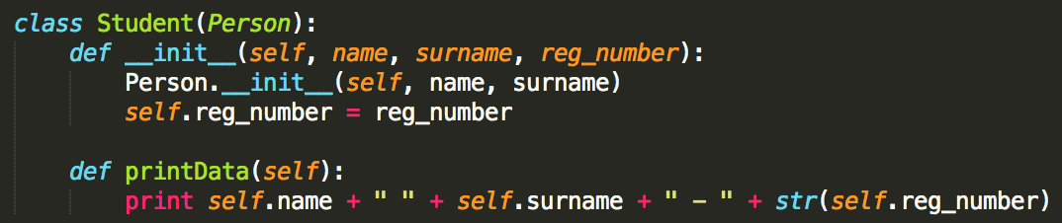
inheritance
Distributed Real-Time Cyber Physical System of Systems - Puccetti Tommaso e Secci Francesco
To implement inheritance, you have to specify the type of the extended class in parentheses as the input parameter of the new class.
Then you have to use the constructor of the extended class to inherit all of the fields of the superclass.

Slide 21
Threads
Distributed Real-Time Cyber Physical System of Systems - Puccetti Tommaso e Secci Francesco
Running several threads is similar to running several different programs concurrently.
Multiple threads within a process share the same data space with the main thread and can therefore share information or communicate with each other more easily than if they were separate processes.
Threads sometimes called light-weight processes and they do not require much memory overhead (they are cheaper than processes).
A thread has a beginning, an execution sequence, and a conclusion.

Slide 22
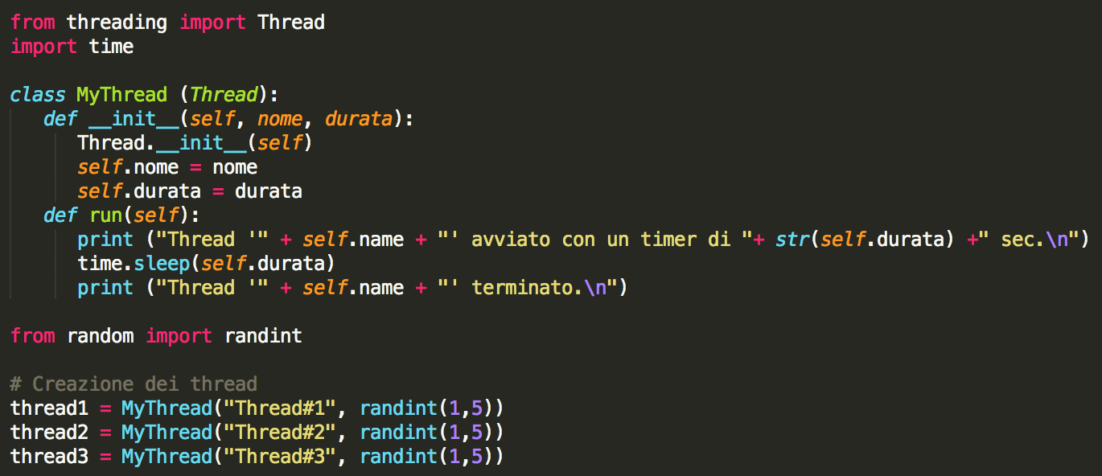
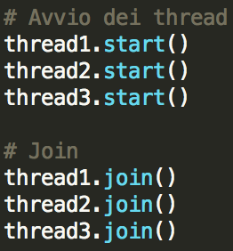
Threads (continue)
Distributed Real-Time Cyber Physical System of Systems - Puccetti Tommaso e Secci Francesco

Slide 23
Threads – start()/run() and join() methods
Distributed Real-Time Cyber Physical System of Systems - Puccetti Tommaso e Secci Francesco
Class Thread → the thread’s creation needs a class definition which inherits from the Thread class.
run() → Moreover, you need to override the run method of the superclass (Thread) in order to specifies the thread operations.
start() → this method starts thread by calling the run() method.
join() → this method waits for threads to terminates.

Slide 24
threads - Question
Distributed Real-Time Cyber Physical System of Systems - Puccetti Tommaso e Secci Francesco
How can I implement a critical section?

Slide 25
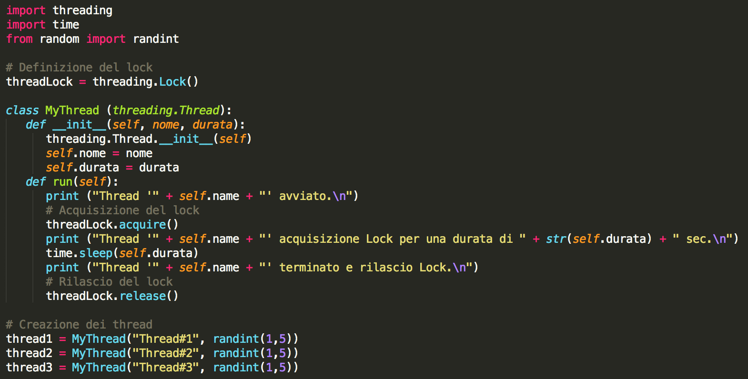
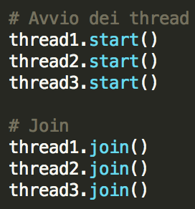
Distributed Real-Time Cyber Physical System of Systems - Puccetti Tommaso e Secci Francesco
Threads – lock acquire() and release()

Slide 26
Distributed Real-Time Cyber Physical System of Systems - Puccetti Tommaso e Secci Francesco
group exercise
Sensor System that controls the battery charge (4 sensors is enough)
A thread each sensors
Shared resources: a list of values ​​and the average of its values
Print the log
Consider a delay (sleep) at each call of the .start method

Slide 27
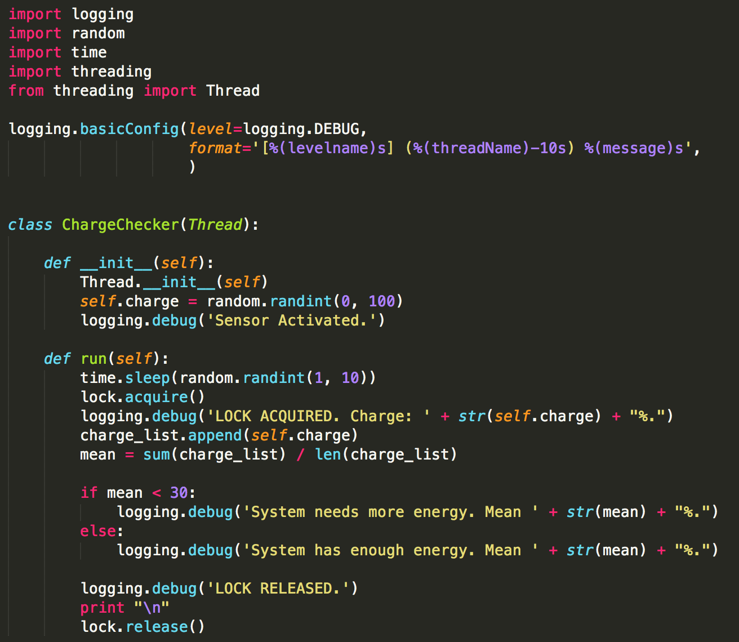
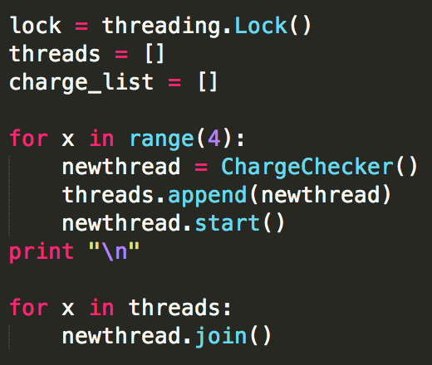
Exercise – a solution
Distributed Real-Time Cyber Physical System of Systems - Puccetti Tommaso e Secci Francesco

Slide 28
Thanks for the attention!

